Slide 1
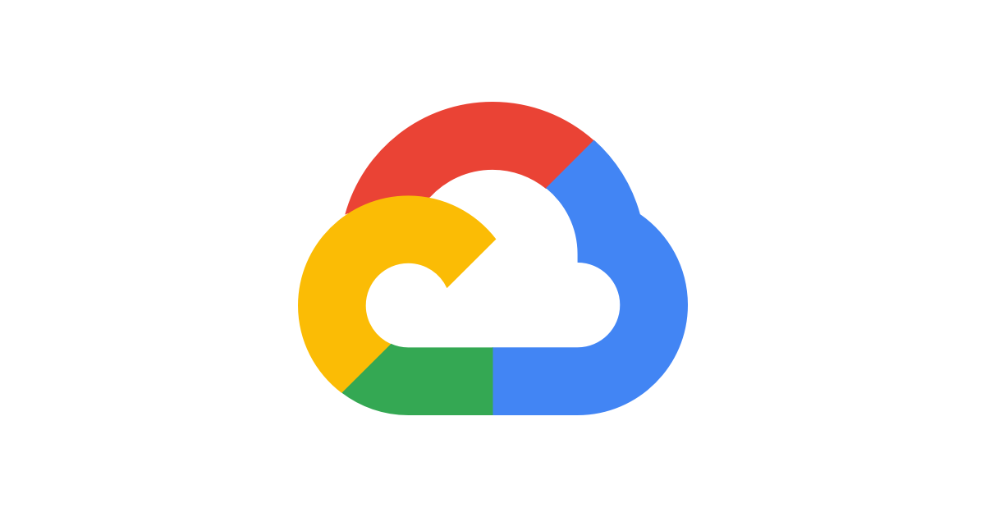
GCP Implementation
PRESENTED BY:
Samridhi Pandey
Vamsi Krishna Lukka
Akanksha Kashyap
Venkatesh Mahanti
Sudeep Sherikar
MENTOR:
MR. PARTH SHUKLA

Slide 2
Deploying front-end (Angular application)

Slide 3
Angular Application Deployment
Open the Angular project location and build the angular project using command :
ng build
Confirm the application is built at the location Example:
dist\SHOP FOR HOME
Create an app.yamL file which specifies how URL paths correspond to request handlers and static files.
Authorize the Google cloud CLI using command: gcloud auth login
Login with the google cloud account you are creating the project in the browser
Set your google cloud project id using the command:
gcloud config set project qwiklabs-gcp-00-761562dc8a9c

Slide 4
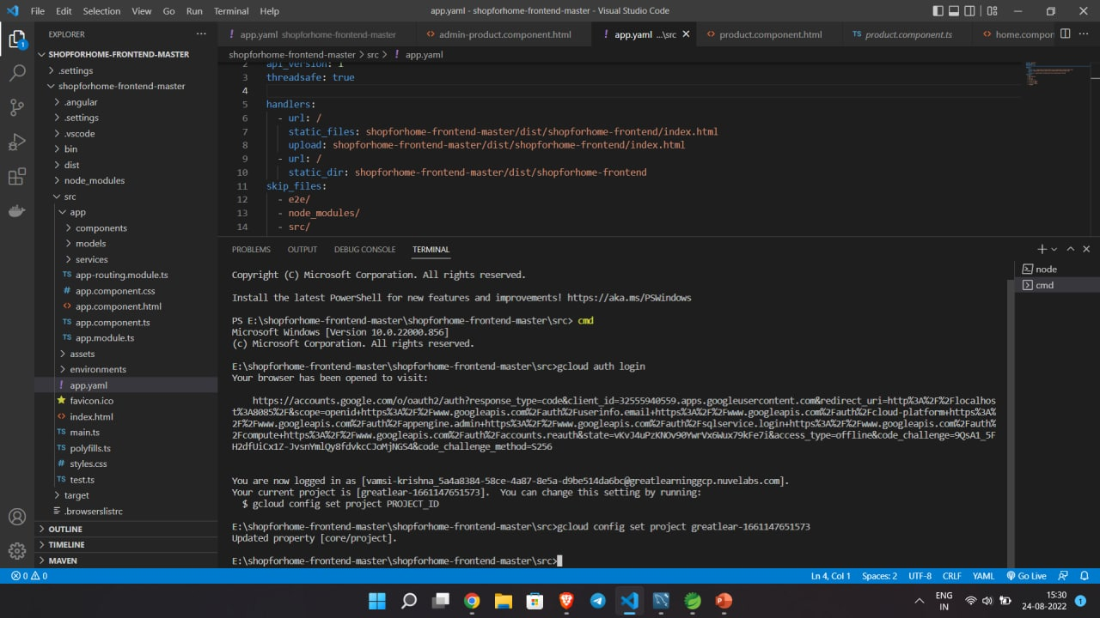

Slide 5
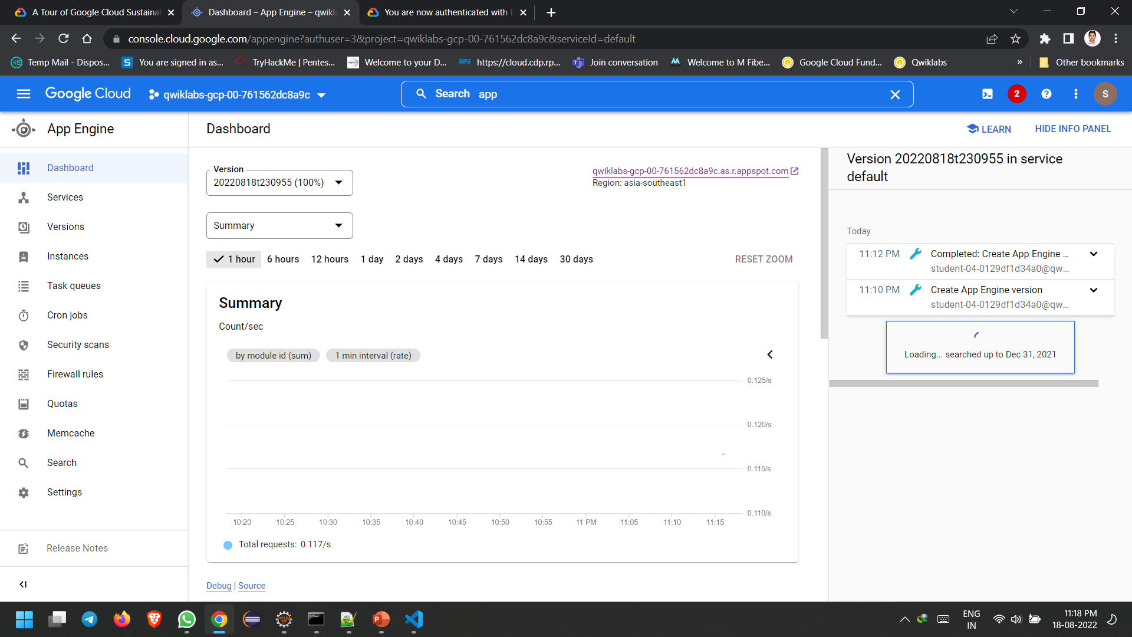
Now deploy the project using :gcloud app deploy --project=qwiklabs-gcp-00-761562dc8a9c where (qwiklabs-gcp-00-761562dc8a9c) is the [Project Id]

Slide 6
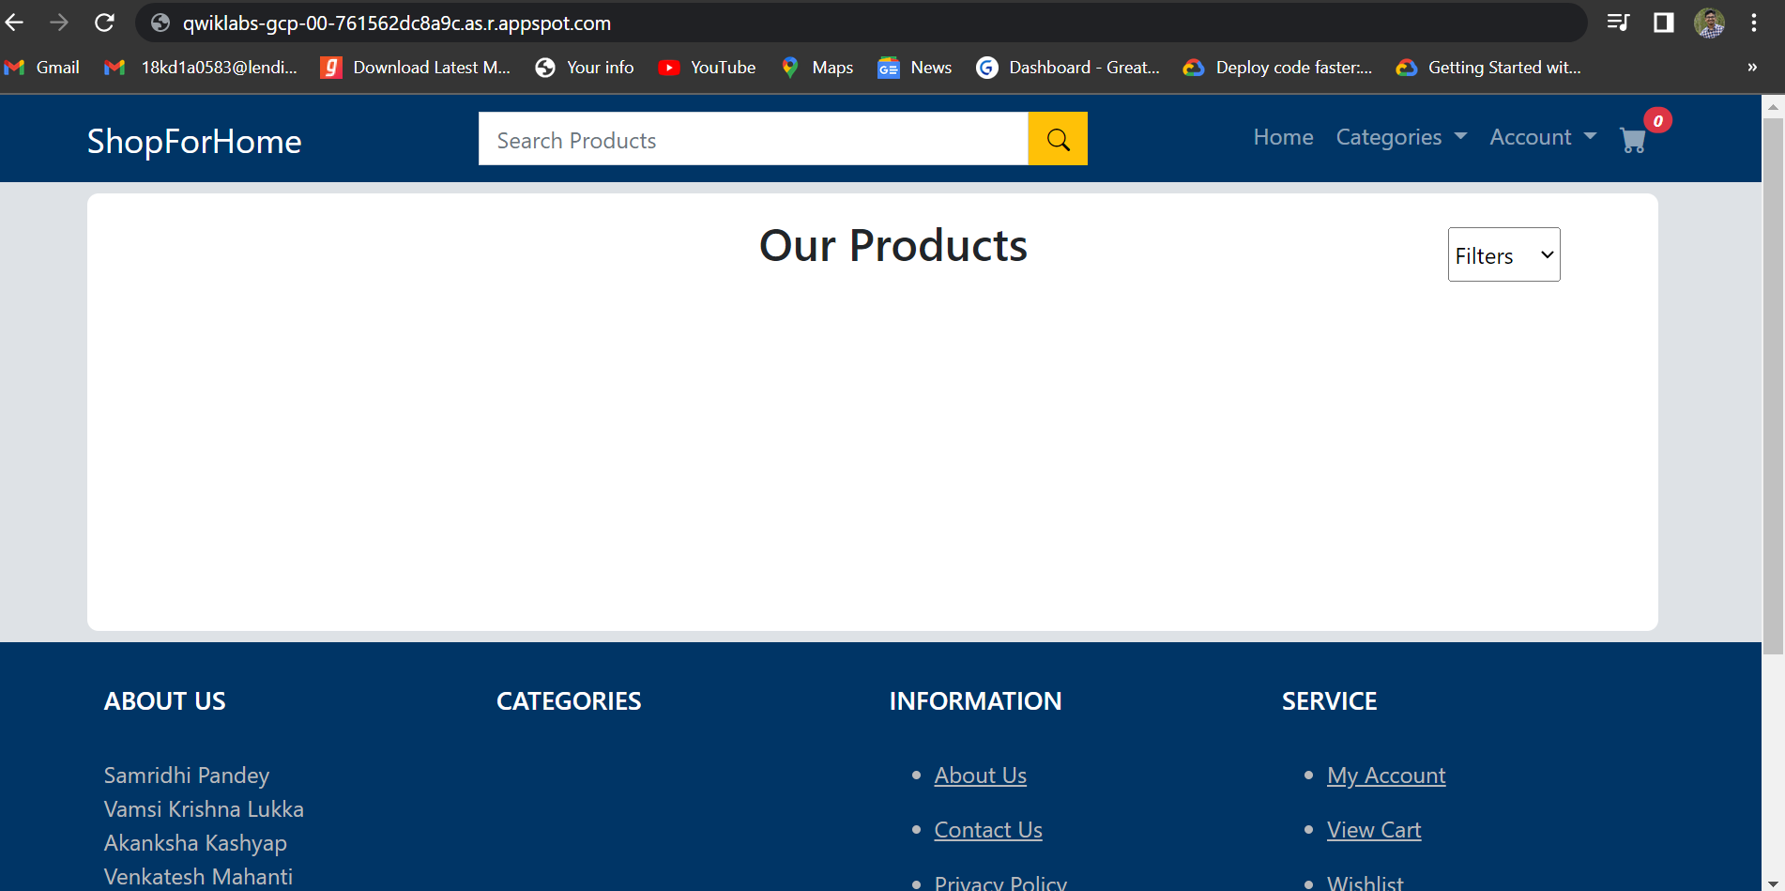
Deployed Angular application

Slide 7
Deploying back-end (Springboot application)

Slide 8
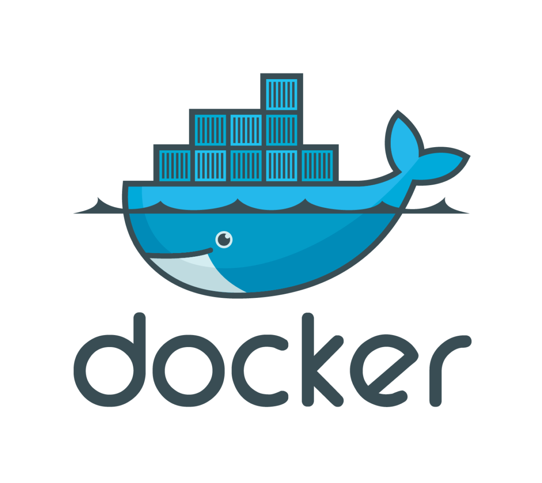
Containerization of springboot application
Install Docker Desktop on your Computer
Sign in with your docker credentials into the Docker Desktop
Add the cloud dependedncies to your maven applications
Add the Docker File to the maven project as shown
Now build the maven application.
Now go to the application folder in Command Prompt and follow the following steps

Slide 9
The below code is added to all pom.xml files.
<dependency>
<groupId>com.google.cloud</groupId>
<artifactId>spring-cloud-gcp-dependencies</artifactId>
<version>3.0.0</version>
<type>pom</type>
<scope>import</scope>
</dependency>

Slide 10
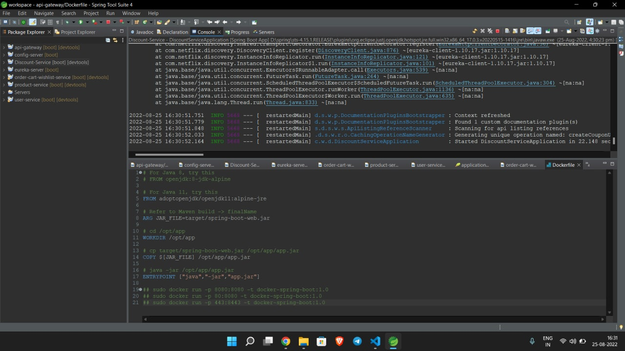

Slide 11
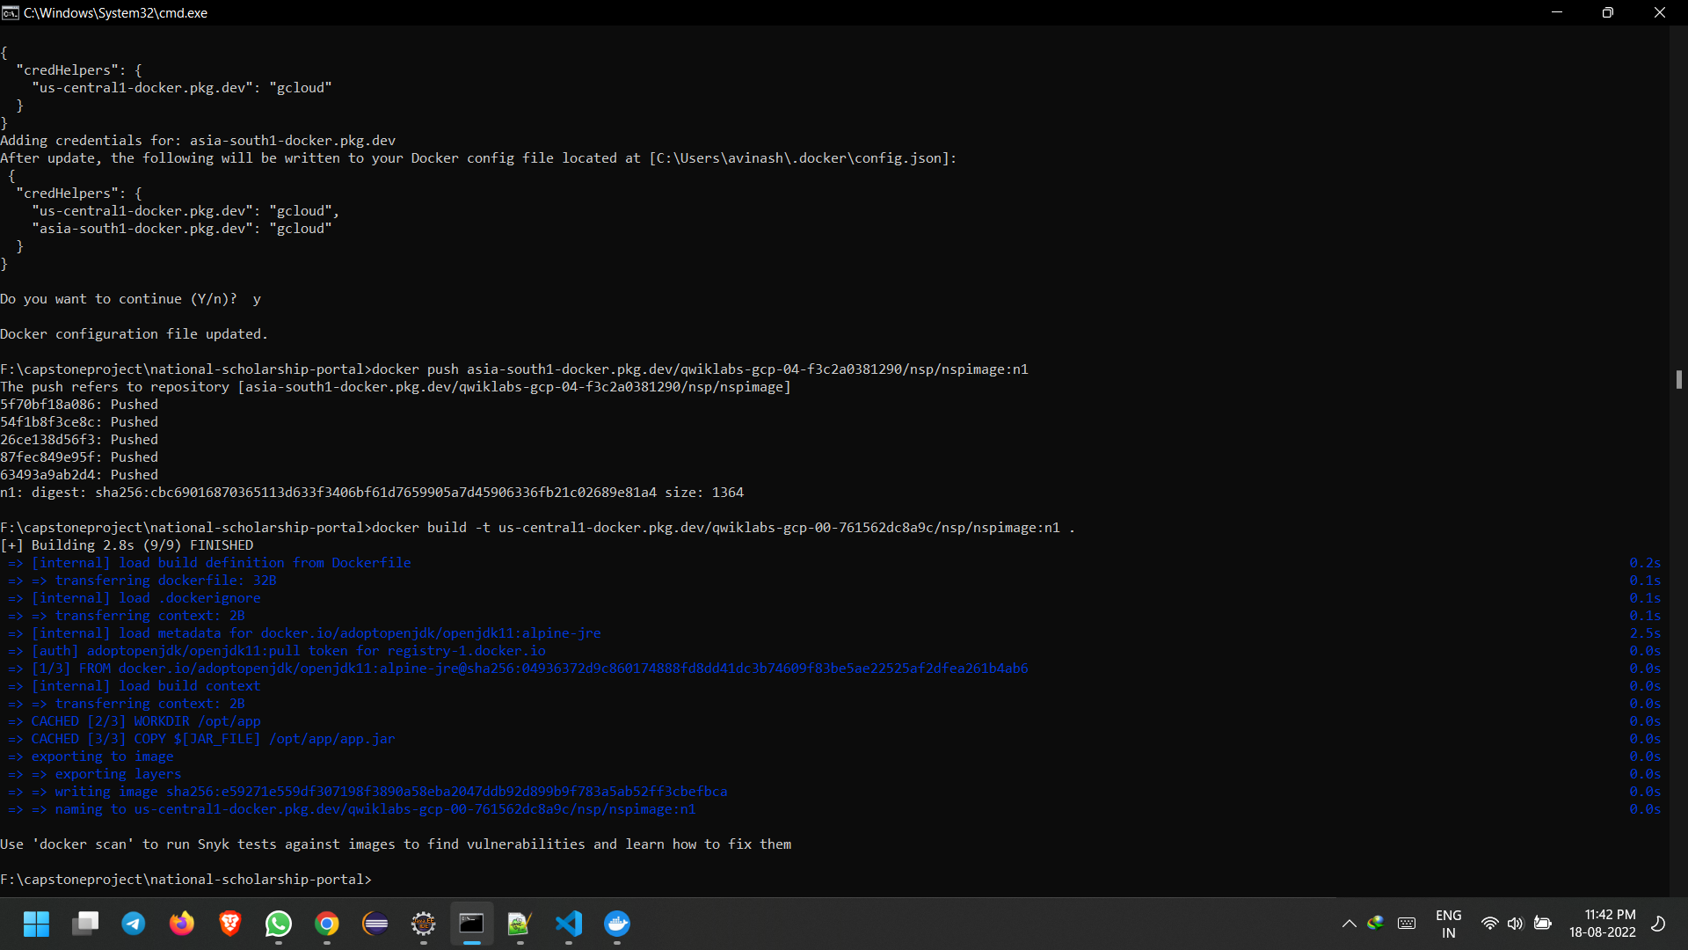
Build the container image using the below command:
docker build -t asia-south1-docker.pkg.dev/qwiklabs-gcp-04-f3c2a0381290/nsp/nspimage:n1
After building you can list and check the docker image created by using the command :
docker images

Slide 12
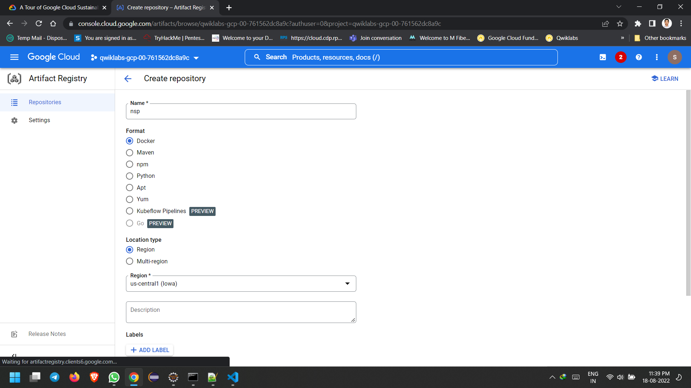
Pushing the container image to Artifact registry
Create a Artifact Registry Repository in the Cloud as shown
Log into google cloud using below command in cmd
gcloud auth login
Set your google cloud project id using the command
gcloud config set project qwiklabs-gcp-00-761562dc8a9c
Authenticate your artifact registry using below command
gcloud auth configure-docker us-central1-docker.pkg.dev

Slide 13
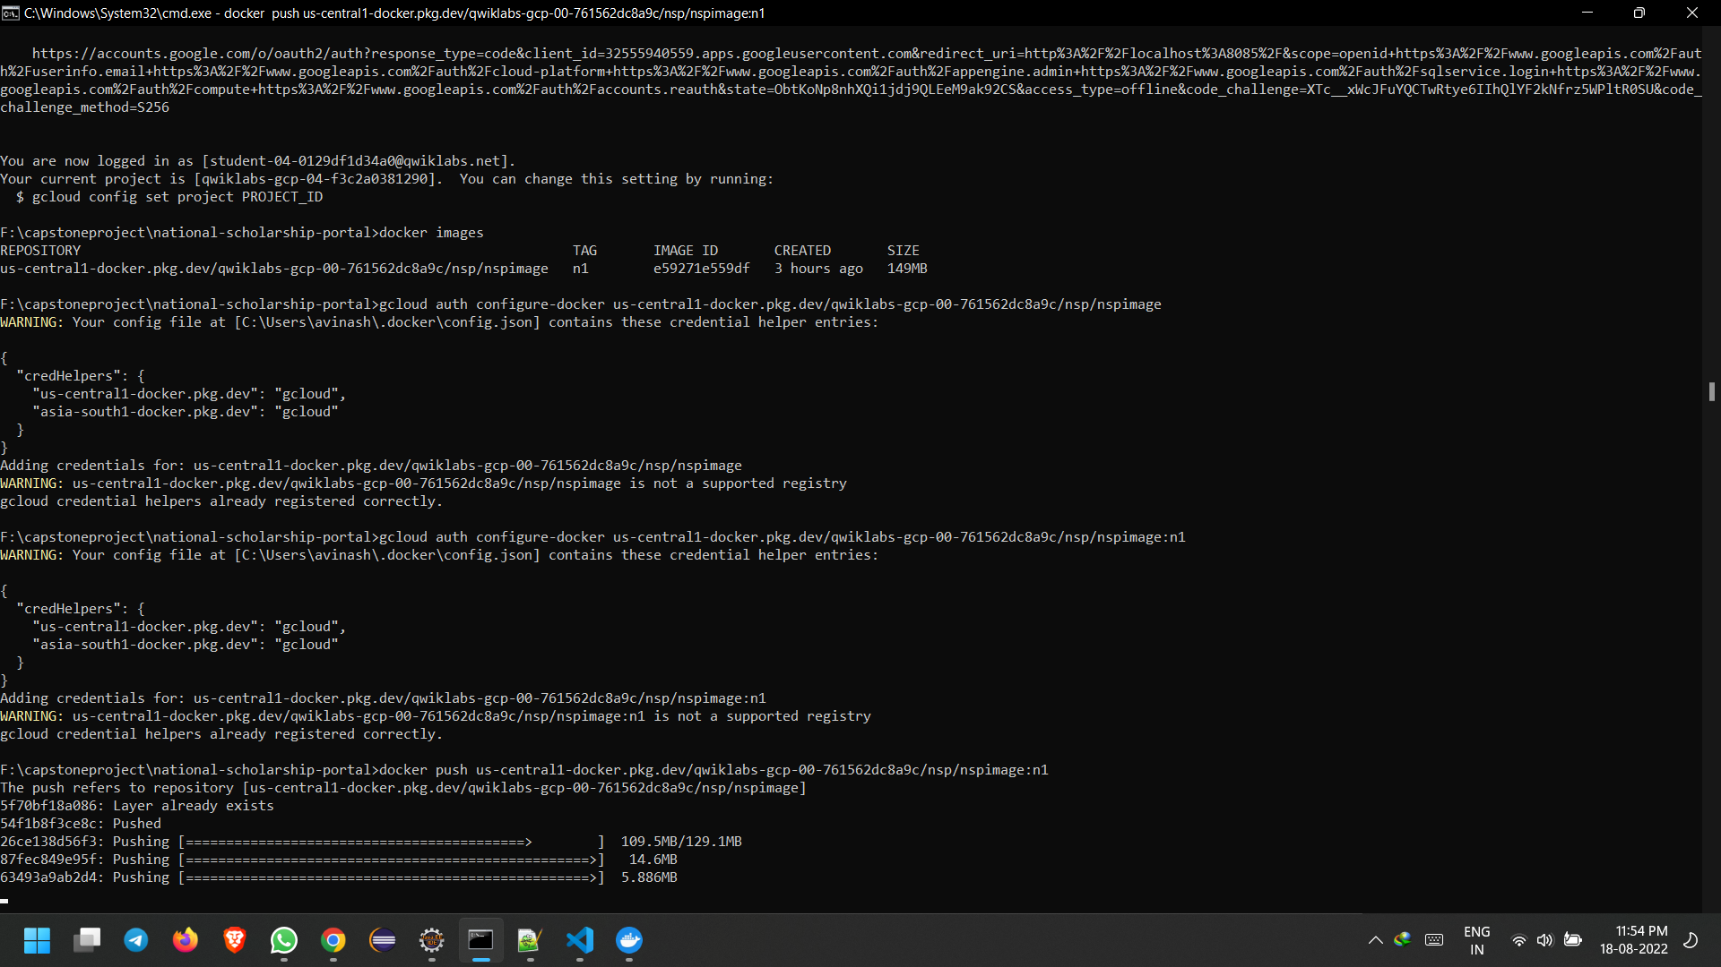
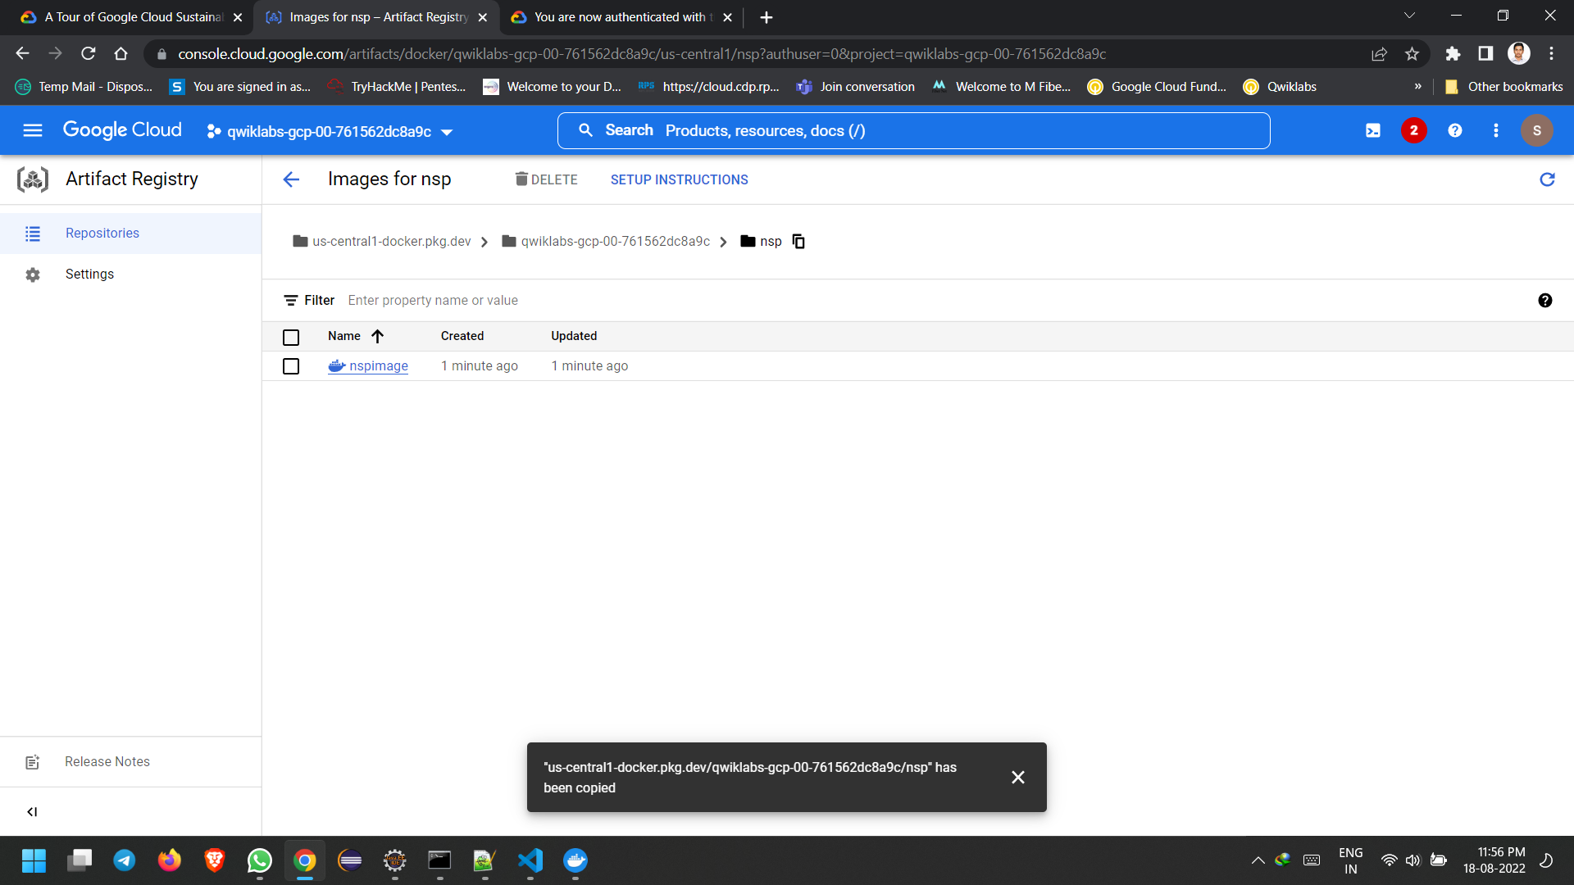
Push your container image into the artifact registry using the following command.
docker push us-central1-docker.pkg.dev/qwiklabs-gcp-00-761562dc8a9c/nsp/nspimage:n1

Slide 14
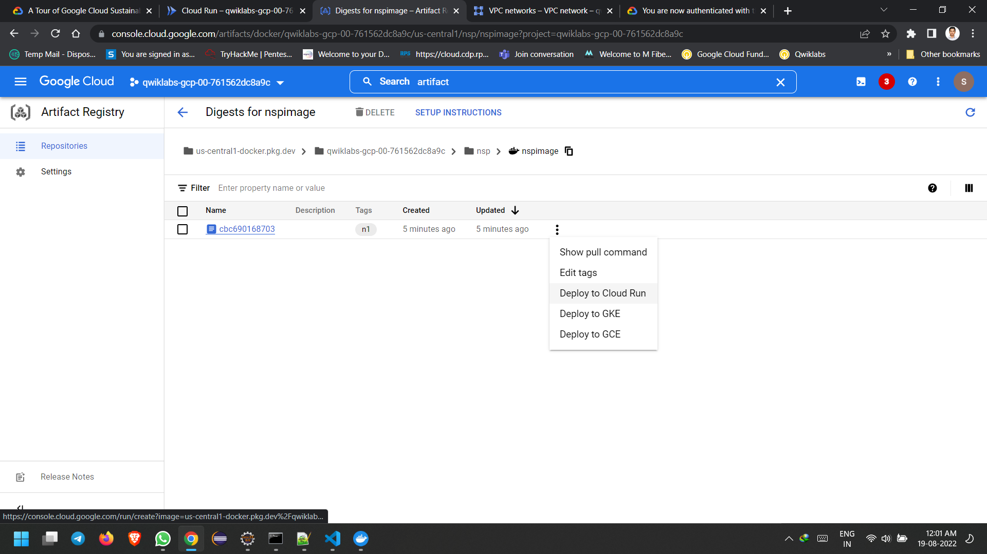
Deployment of Container Image in Cloud Run

Slide 15
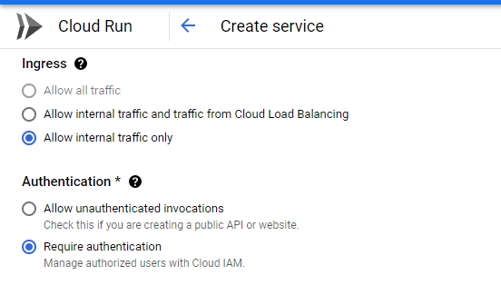
Fill the fields with appropriate details and deploy.
Provide a unique service name and select ‘Require authentication’ in Authentication section as in the below screenshot

Slide 16
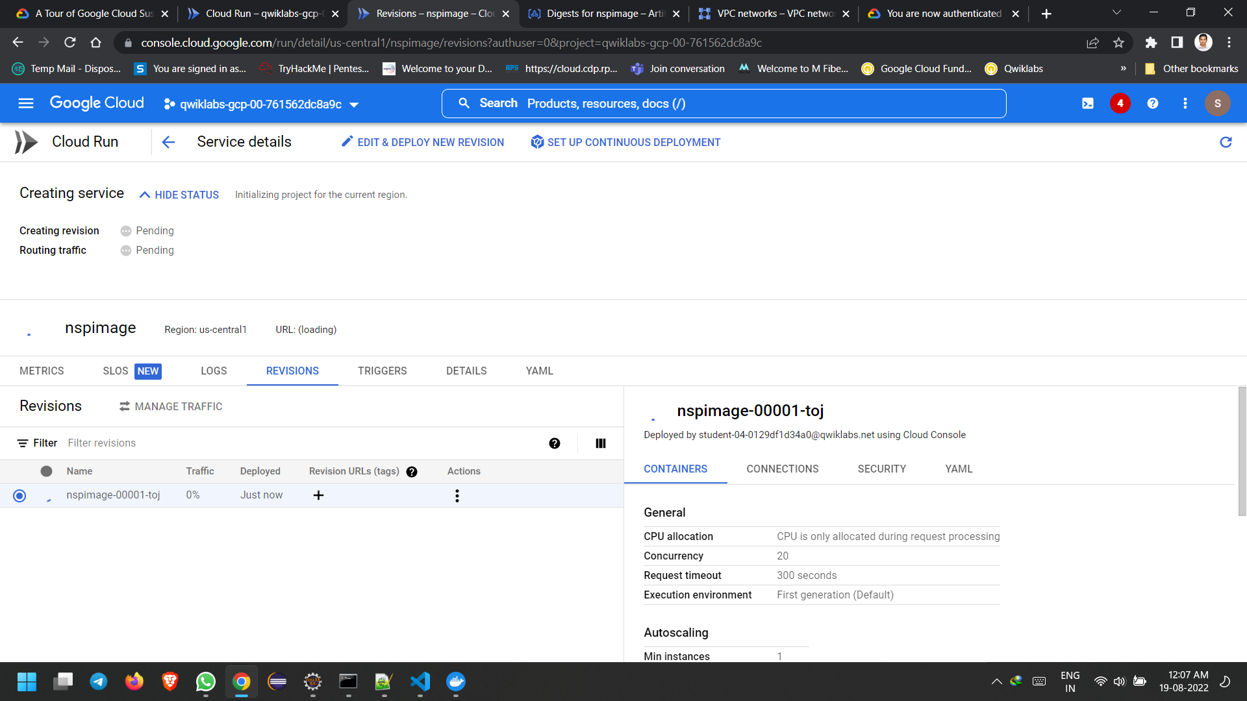
Under Connections tab of ‘Container, Variables & Secrets, Connections, Security’ drop down, select None
Click create. Service will get deployed and URL will be generated by cloud run.

Slide 17
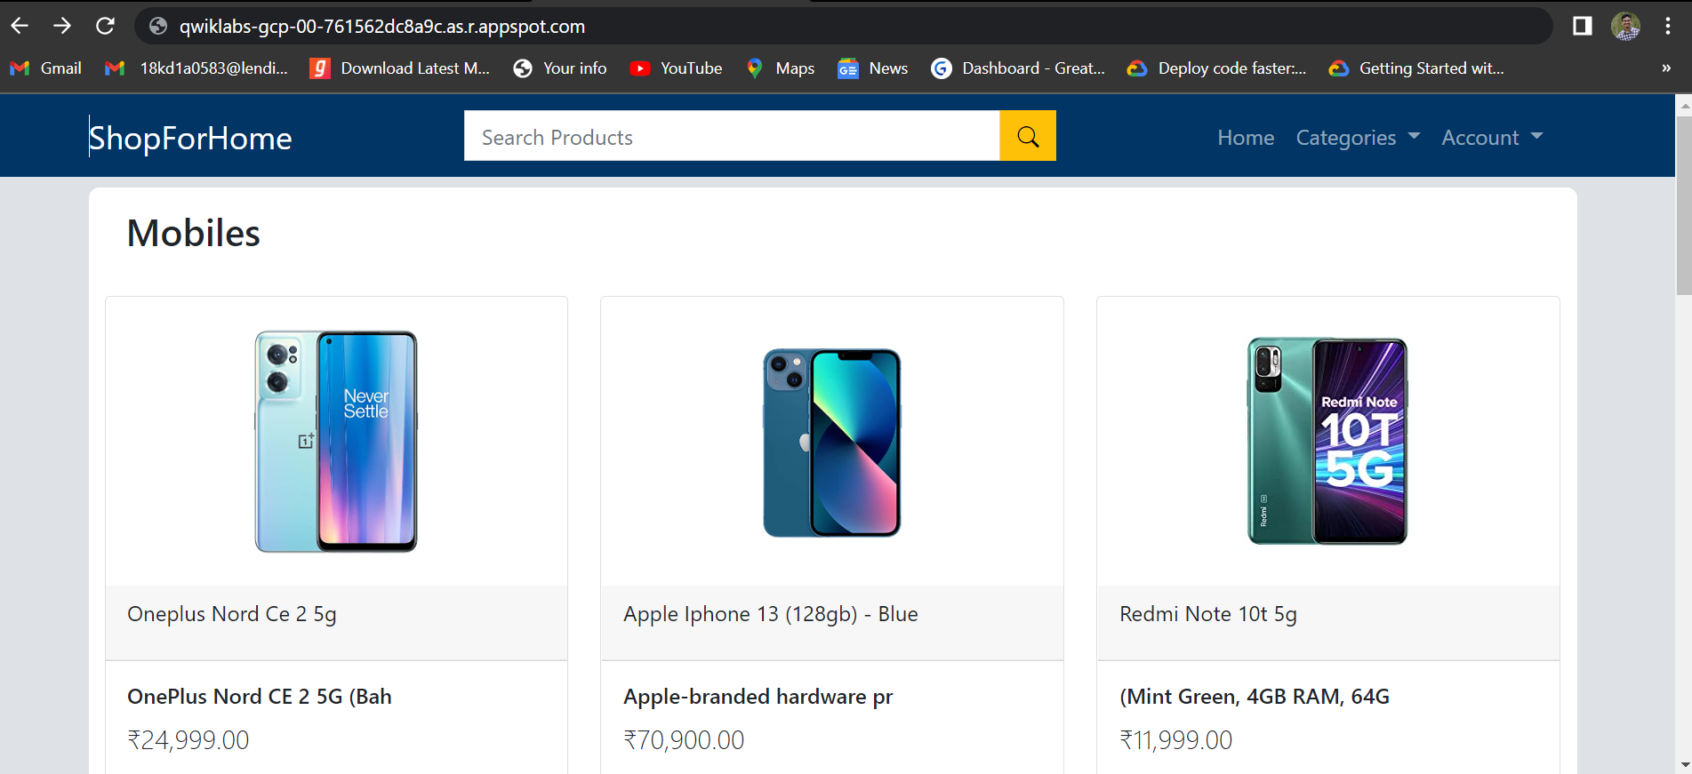

Slide 18


